Slide 1
Gaussian Mixtures
By: Muhammad Subhan Khan

Slide 2
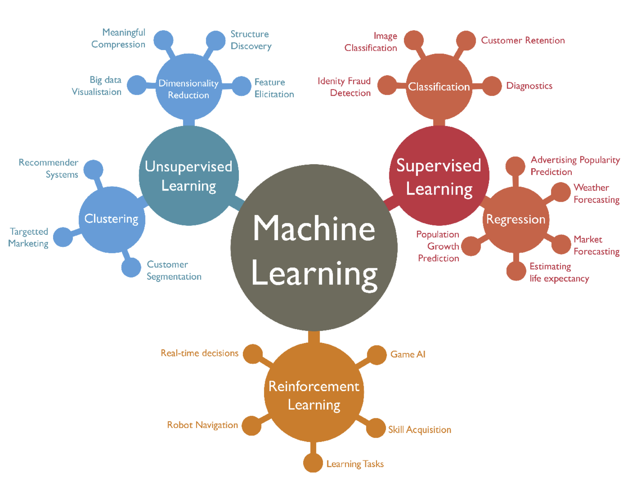
Machine Learning
Figure 1: Machine Learning [5]

Slide 3
Introduction to Gaussian Mixtures
Gaussian Mixtures is a Machine learning algorithm
With the help of this model, data can be classified into various categories
Data is divided into different categories on the basis of probability distribution

Slide 4
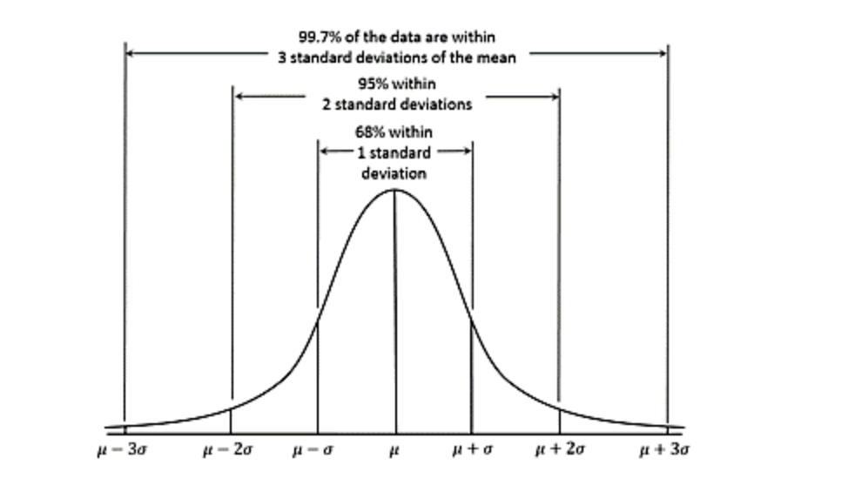
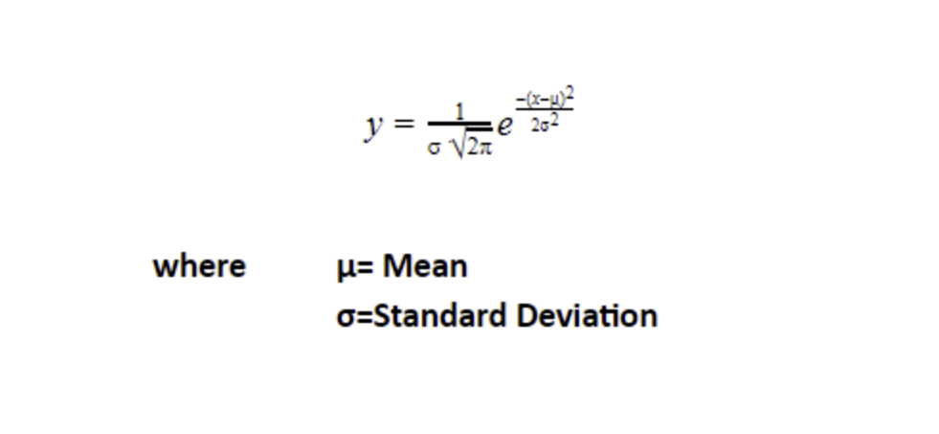
Gaussian Distributions
Gaussian is basically a distribution
Distribution is a listing of results in an experiment and the probability associated with each result produced
Gaussian distribution is defined by the mean and the standard deviation
Probability of a data point being part of the curve can be measured using the probability density function
Figure 1: Example of a Gaussian distribution [4]
Figure 2: Probability density function [4]

Slide 5
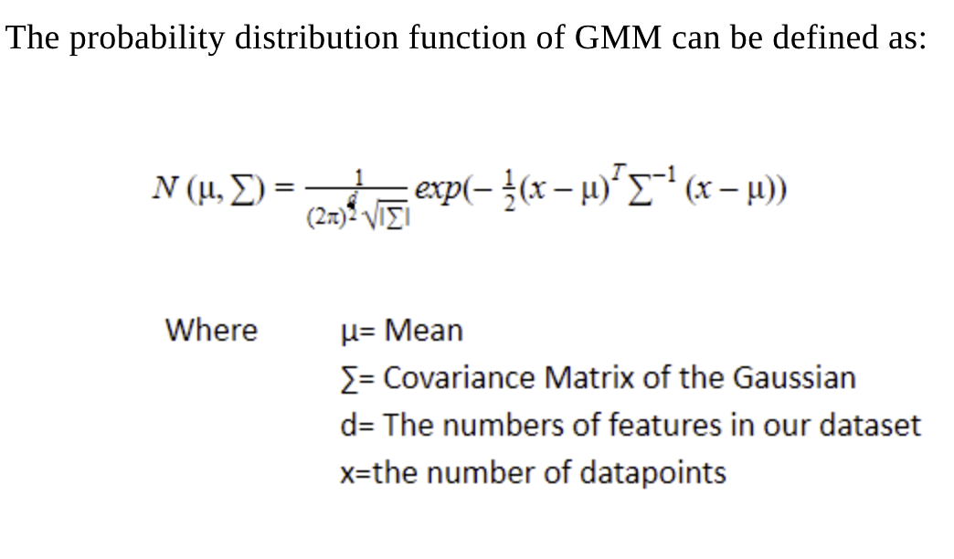
Gaussian Mixture Models
Probability distribution consisting of many distributions
These models can be used for clustering
They are a more generalized version of Gaussian distributions
In simple terms they are models which can help model real world data sets
Figure 3: Probability density function of GMM [4]

Slide 6
Scenarios where Gaussian Mixtures are used
When there is doubt about the number of clusters present, Gaussian Mixtures minimize the rate of errors greatly
Labeling different groups in a dataset
Extremely useful when clusters overlap, as other algorithms will identify the whole cluster as one
Identifying fraud

Slide 7
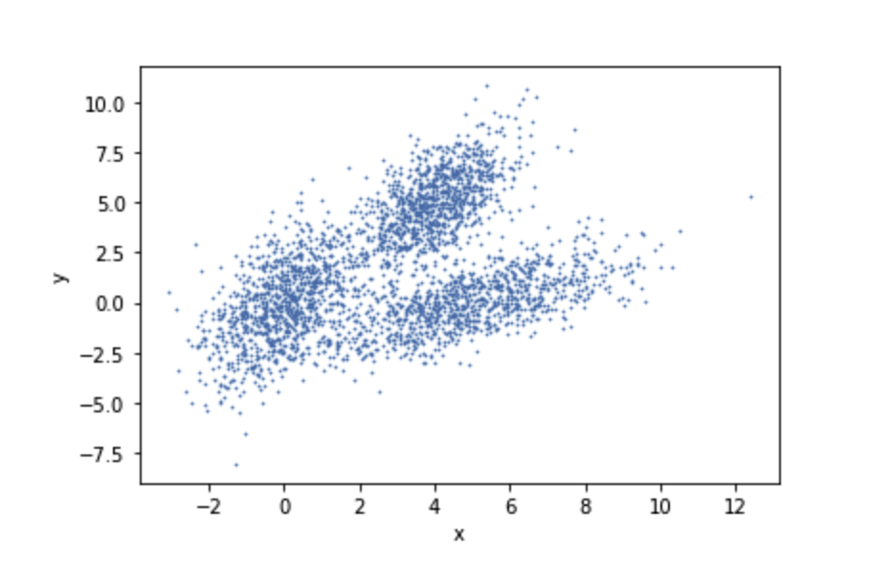
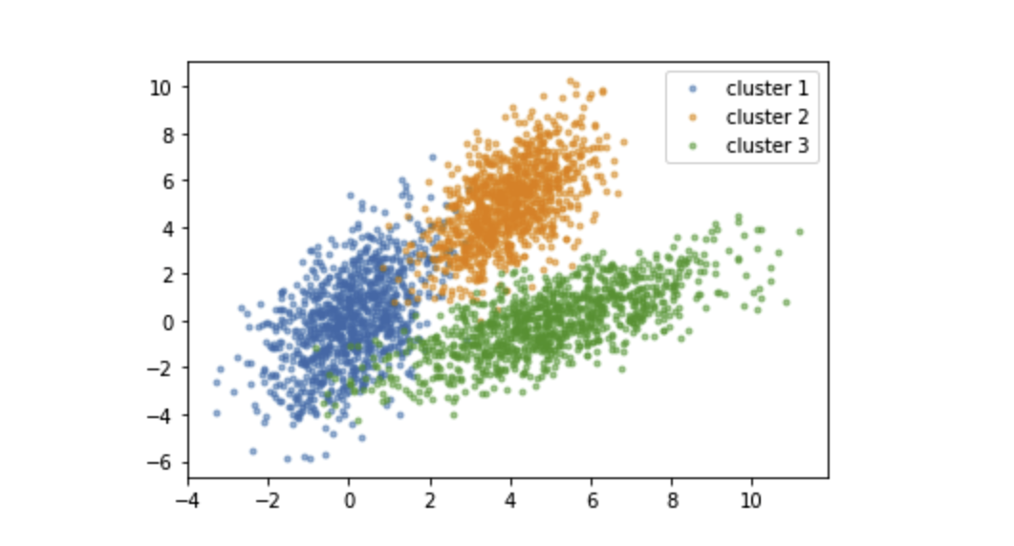
Clustering
Clustering is a method used that divides the population into groups, and the data points which will be present in the group will be similar to each other
Groups with similar traits are clustered together
There are 2 types of clustering types hard and soft clustering
Purpose of unsupervised learning is finding hidden patterns in unlabeled data
Figure 4 : Before clustering [6]
Figure 5: After clustering [6]

Slide 8
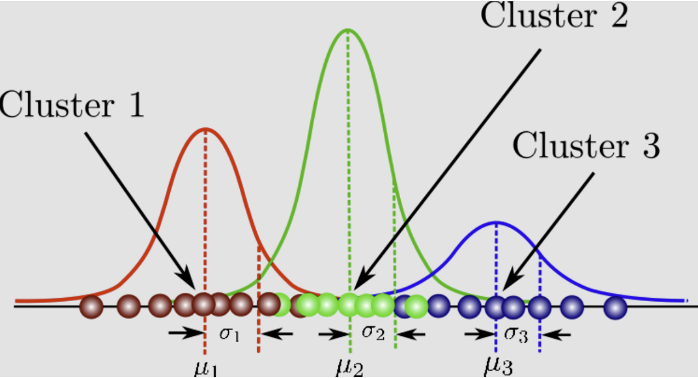
Clustering in Gaussian Mixtures
Gaussian Mixtures can be used in Clustering
Clustering is the task of grouping a set of data
It is a soft clustering algorithm
We can use these models to find clusters in data sets which might be difficult to find via other methods
Figure 6: Clustering in GMM [1]

Slide 9
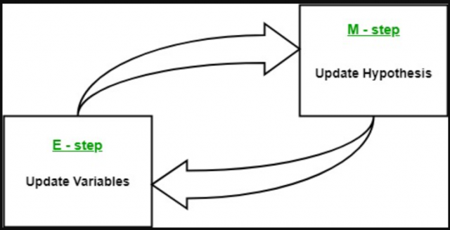
Expectation Maximization In Gaussian Mixtures
This method is used for estimating the parameters (mean, variance, covariance) of the Gaussian Mixtures
E stands for estimation and M stands for maximization
Expectation (E) is used to identify the parameters
Maximization (M) is used to identify the points which can be included and which are not fit to add
Figure 7: Expectation Maximization process [2]

Slide 10
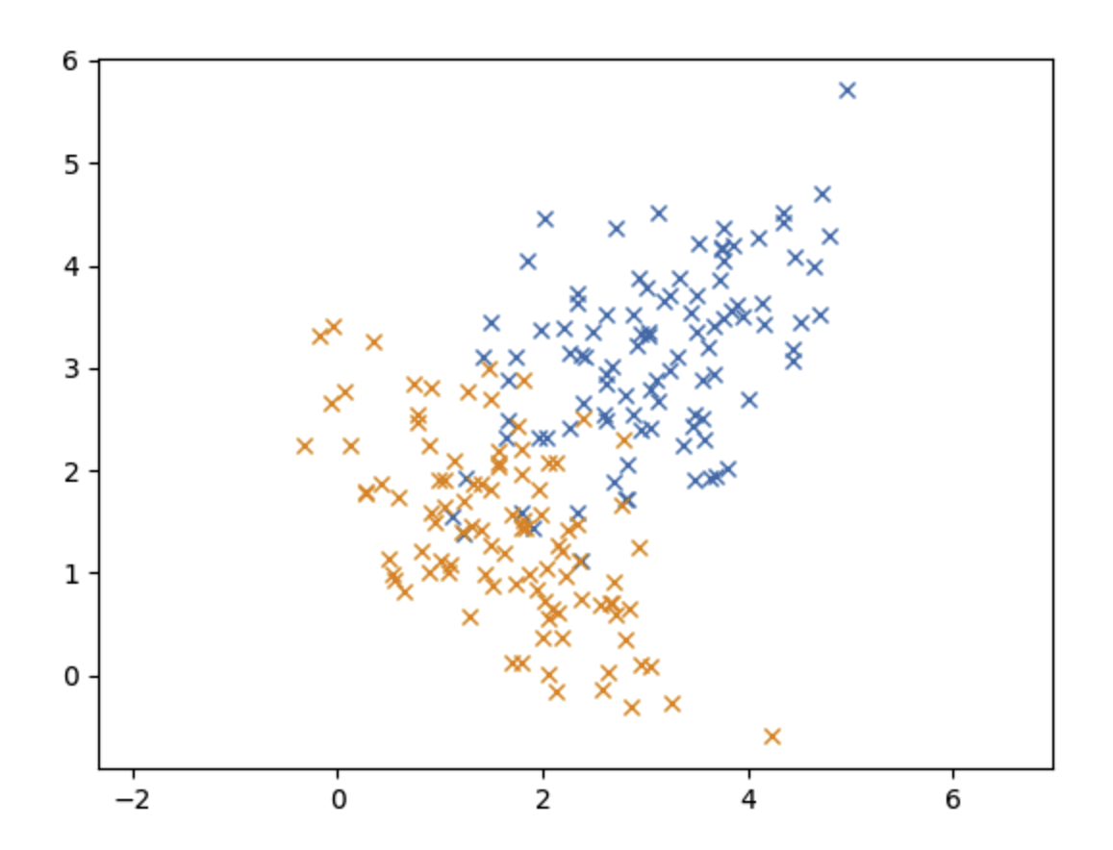
Gaussian Mixture Model compared to other models
An indication of what model to use can be decided from the size of the data set
Gaussian Mixtures are very effective when the data set is smaller and data sets are not separated that well, whereas K-means clustering can be used vice versa
GMM are more flexible as opposed to K-means clustering, as different type of cluster shapes can be taken
Figure 8: Example of overlapping of data [3]

Slide 11
Application of Gaussian Mixtures
Customer Behavior Analysis
Medical Datasets
Earthquake studies
Insurance

Slide 12
Advantages of Gaussian Mixture Models
Higher flexibility, as clusters with different shapes can be taken into account
01
Soft Classification
02
Robust to outliers
03

Slide 13
Disadvantages of Gaussian Mixtures
Limited number of components
01
Slow as number of iterations have too happen to achieve convergence
02
Only number of components that are accessible will be used
03

Slide 14
Conclusion
In conclusion Gaussian Mixtures are useful where the data sets are large and patterns within the dataset have to be identified. GMM has made it very easy to label clusters. Moreover, by using this method, unsupervised data can be converted into data that is classified and clean.

Slide 15
References
[1] Kumar, A. (2022, April 14). Gaussian mixture models: What are they & when to use? Data Analytics. Retrieved May 23, 2022, from https://vitalflux.com/gaussian-mixture-models-what-are-they-when-to-use/#What_is_the_expectation-maximization_EM_method_in_relation_to_GMM
[2]Kumar, A. (2022, April 14). Gaussian mixture models: What are they & when to use? Data Analytics. Retrieved May 23, 2022, from https://vitalflux.com/gaussian-mixture-models-what-are-they-when-to-use/#What_is_the_expectation-maximization_EM_method_in_relation_to_GMM
[3] Deshpande, M. (2022, April 29). Clustering with Gaussian Mixture Models. Python Machine Learning. Retrieved May 24, 2022, from https://pythonmachinelearning.pro/clustering-with-gaussian-mixture-models/
[4] Verma, Y. (2021b, October 25). All You Need to Know About Gaussian Mixture Models. Analytics India Magazine. Retrieved May 28, 2022, from https://analyticsindiamag.com/all-you-need-to-know-about-gaussian-mixture-models/
[5] Shewan, D. (2021, December 3). 10 Companies Using Machine Learning in Cool Ways. WordStream. Retrieved May 28, 2022, from https://www.wordstream.com/blog/ws/2017/07/28/machine-learning-applications
[6] Alireza Khanteymoori, Anup Kumar, 2021 Clustering in Machine Learning (Galaxy Training Materials). https://training.galaxyproject.org/training-material/topics/statistics/tutorials/clustering_machinelearning/tutorial.html Online; accessed Sat May 28 2022

